Slide 1


Java 9 Overview
Bogdan Tkach
Oct 18, 2017

Slide 2

Agenda
1
Modularization
2
REPL
3
Other various improvements

Slide 3
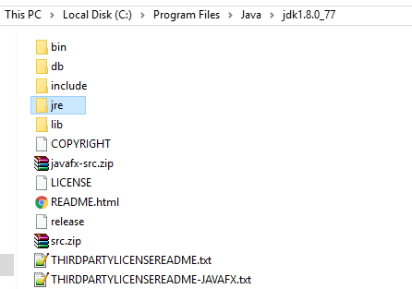
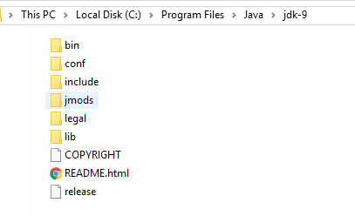
Java 8 vs 9

Slide 4
Java Modules
Modules are a new way of grouping code and data.
Modules explicitly declare which modules they depend on, and what packages they export.
java --list-modules

Slide 5
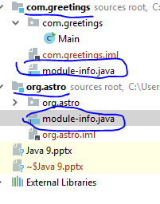
Java Module

Slide 6
Java Module – module-info.java
REQUIRES – define dependencies on other modules
EXPORTS – define packages available to other modules

Slide 7
Compiling and Running module
javac
-d mods/org.greetings org.greetings/module-info.java org.greetings/org/greetings/Main.java
java
--module-path mods
-m com.greetings/com.greetings.Main

Slide 8
Creating modular application
1
module-info.java – require and export
2
javac --module-path
3
jlink

Slide 9
Using with Maven
When migrating to Java 9 many maven plugins has to be updated
https://cwiki.apache.org/confluence/display/MAVEN/Java+9+-+Jigsaw

Slide 10
Java REPL
1
Semicolon is optional on bare statements
2
No checked exceptions
3
Forward reference

Slide 11
Collection Factories
1
List.of(…)
2
Set.of(…)
3
Map.of(…) Map.ofEntiries(…)

Slide 12
Improved try with resources
// A final resource final Resource resource1 = new Resource("resource1");
// Original try-with-resources statement from JDK 7 or 8 try (Resource r1 = resource1) { // Use of resource1 and resource 2 through r1 and r2. }
// New and improved try-with-resources statement in JDK 9 try (resource1) { // Use of resource1 and resource 2. }

Slide 13
Stream API improvements
1
Stream.takeWhile() / Stream.dropWhile()
2
Optional.stream();

Slide 14
Private interface methods
public interface MyInterface { void normalInterfaceMethod(); default void interfaceMethodWithDefault() { init(); } default void anotherDefaultMethod() { init(); } // This method is not part of the public API exposed by MyInterface private void init() { System.out.println("Initializing"); } }

Slide 15
Others
1
HTTP/2 (incubator module)
2
Improved Javadoc – HTML 5 and search
https://docs.oracle.com/javase/8/docs/api/
http://download.java.net/java/jdk9/docs/api/overview-summary.html
3
Flow API – Publisher and Subscriber

Slide 16
Questions?

